Slide 1


Subtopic N1.20 – Place Value Systems Beyond Base 10
LEARNING OUTCOME: To gain an understanding of the binary system
Objectives:
Keywords:
Base 10
Base 2
Binary
To understand the binary system
To convert between base 10 and base 2
Definition
Characteristics
Binary numbers are a way of representing numbers using only two digits, 0 and 1. It is also known as the base-2 number system.
Binary numbers use only two digits, 0 and 1, unlike our decimal system, which uses ten (0-9).
Each digit in a binary number represents a specific place value, just like in our decimal system. In binary, each place value is a power of 2. The rightmost digit represents 2⁰ (1), the next represents 2¹ (2), then 2² (4), 2³ (8), and so on.
Binary
1101
In binary, base 2, there are only two digits (0 and 1) and each place is worth two times the place to the right
Non - Examples
Examples
3671
In base 10, there are ten digits (0-9) and each place is worth ten times the place to the right
Decimal 0 is written as binary 0.
Decimal 1 is written as binary 1
Decimal 2 is written as binary 10 (1 two and 0 ones)
Decimal 3 is written as binary 11 (1 two and 1 one)
Decimal 4 is written as binary 100 (1 four, 0 twos, and 0 ones)
Roman numerals, such as III, XI, IV
Converting from base 10 to binary
Example 1 - I do…
Example 2 - We do…
Example 3 – You do…
Steps | Write 15 in binary: | Write 17 in binary: | Write 19 in binary:
1) Look for the biggest binary place value column that is smaller than the base 10 number. 2) Write a 1 in this column. 3) Find the remainder and repeat. | 1111 | 10001 | 10011
16 | 8 | 4 | 2 | 1
16 | 8 | 4 | 2 | 1
16 | 8 | 4 | 2 | 1

Slide 2
Independent Practice
Q1. Represent the following base 10 numbers in binary (base 2):
a) 21
b) 25
g) 130 | h) 160
i) 175 | j) 200
32 | 16 | 8 | 4 | 2 | 1
 | 1 | 0 | 1 | 0 | 1
32 | 16 | 8 | 4 | 2 | 1
 | 1 | 1 | 0 | 0 | 1
10101
11001
c) 31
d) 35
32 | 16 | 8 | 4 | 2 | 1
 | 1 | 1 | 1 | 1 | 1
32 | 16 | 8 | 4 | 2 | 1
1 | 0 | 0 | 0 | 1 | 1
11111
100011
e) 63
f) 100
64 | 32 | 16 | 8 | 4 | 2 | 1
 | 1 | 1 | 1 | 1 | 1 | 1
64 | 32 | 16 | 8 | 4 | 2 | 1
1 | 1 | 0 | 0 | 1 | 0 | 0
111111
1100100
10000010
10100000
10101111
11001000
Converting from binary 10 to base 10
Example 4 - I do…
Example 5 - We do…
Example 6 – You do…
Steps | Write 1101 in base 10: | Write 10110 in binary: | Write 10010 in binary:
1) Multiply each binary digit by its corresponding power of 2. 2) Add these together. | 13 | 22 | 18
16 | 8 | 4 | 2 | 1
16 | 8 | 4 | 2 | 1
16 | 8 | 4 | 2 | 1

Slide 3
Independent Practice
Q2. Represent the following binary numbers in base 10:
a) 111
b) 100
g) 100101 | h) 1101000
i) 1011101 | j) 10100110
 |  |  | 4 | 2 | 1
 |  |  | 1 | 1 | 1
 |  |  | 4 | 2 | 1
 |  |  | 1 | 0 | 0
7
4
c) 101
d) 110
 |  |  | 4 | 2 | 1
 |  |  | 1 | 0 | 1
 |  |  | 4 | 2 | 1
 |  |  | 1 | 1 | 0
5
6
e) 1111
f) 1011
 |  | 8 | 4 | 2 | 1
 |  | 1 | 1 | 1 | 1
 |  | 8 | 4 | 2 | 1
 |  | 1 | 0 | 1 | 1
15
11
37
104
93
166
Q3. Jason is trying to write the number 24 as a binary number.
His answer is 10112
What mistake has Jason made?
Binary numbers only consist of the digits 0 and 1. Jason has a ‘2’ in his binary number. The answer should be 11000
 | 16 | 8 | 4 | 2 | 1
 | 1 | 1 | 0 | 0 | 0

Slide 4
Q4.
A palindromic number is a number which is the same written forwards and backwards.
For example, 525 and 1881 are palindromic numbers.
Georgina says that 33 is a palindrome when written as a decimal number and as a binary number.
Show Georgina is correct.
(b) Nicola says that 99 is also a palindrome when written as decimal number and as a binary number. Show Nicola is correct.
16 8 4 2 1
1 0 0 0 0 1
64 32 16 8 4 2 1
1 1 0 0 0 1 1
Q5. Carry out the following calculations, giving your answer as a binary number:
a) 10010 + 01101 | b) 1110 + 101
c) 1011 + 1101 | d) 00100101 + 01000100
e) 10110 – 1001 | f) 11001 - 1010
11111
10011
11000
01101001
1101
1111
Skills Check
What is the binary representation of the decimal number 12? 1010 1100 1111 1001
What is the decimal representation of the binary number 10101? 21 15 17 19

Slide 5
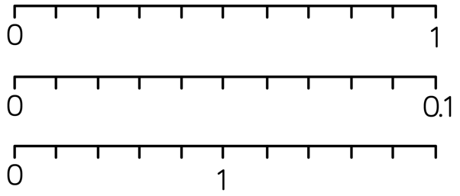
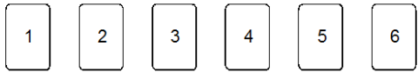
Method Selection
Mixed Fluency
a) Write Three hundred thousand, five hundred and twenty−nine in figures b) Write Seven million, five hundred and two thousand, seven hundred and nineteen in figures c) Write 50,000,012 in words | Write the value of the 4 in each of these numbers: 34601 3.46 43.6 3.64 14.63 f) Now find the median of the five numbers above.
Write these numbers in words: 5.7 5.006 3.02 | Complete each of the following scales:
Unfamiliar Contexts
Hannah is recording the number of letters in each word in an article. These are the first ten lengths. 3 4 5 6 2 4 3 7 3 6 The 11th word has 4 letters. Tick the correct box to describe how the median will be affected. The median will decrease The median will remain the same The median will increase
Here are six number cards. Using all the numbers, what is the smallest number you can make which would round to 1.2?
300,529
4000 (4 thousands)
0.4 (4 tenths)
40 (4 tens)
0.04 (4 hundredths)
7, 502, 719
4 (4 ones)
Fifty thousand and twelve
14.63
Five point seven or Five and seven tenths
0.1 0.2 0.3 0.4 0.5 0.6 0.7 0.8 0.9
Five point zero zero six or Five and six thousandths
0.01 0.02 0.03 0.04 0.05 0.06 0.07 0.08 0.09
Three point zero two or Three and two hundredths
0.2 0.4 0.6 0.8 1.2 1.4 1.6 1.8 2
✓
1.23456

Slide 6
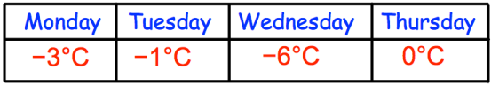
Method Selection
Unfamiliar Contexts (continued)
Shown below are the temperatures recorded over four days. On which day was the lowest temperature recorded? Arrange the temperatures in order, starting with the lowest.
The value of the bold digit in the number 17.405 is 4 tenths. In each of the following, how many times the size of 4 tenths is the value of the underlined digit? a) 47.105 b) 14.705 c) 17.504
What values can each missing digit take? List all possibilities 4?90 = 4000 to the nearest 1000 9?12 = 10,000 to the nearest 1000 34,?90 = 30,000 to the nearest 10,000
Give an example of a number that remains the same when rounded to one, two or three decimal places. | What is the difference between four tenths and forty hundredths? Explain your answer.
Wednesday
-6ºC, -3ºC, -1ºC, 0ºC
100
10
0.01 (accept ÷ 100)
4, 3, 2, 1, 0
5, 6, 7, 8, 9
9, 8, 7, 6, 5, 4, 3, 2, 1, 0
e.g. 5.0004
No difference. They are equivalent.

Slide 7
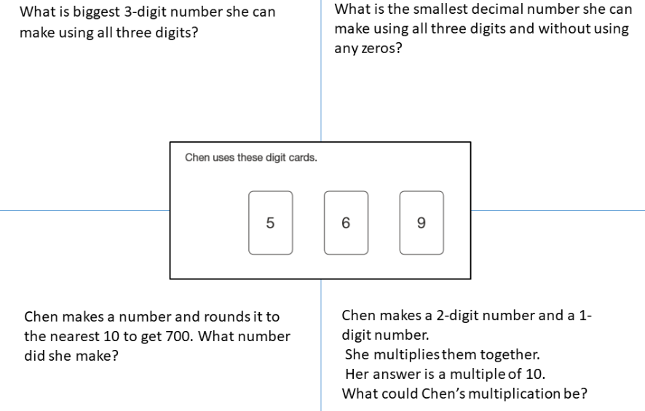
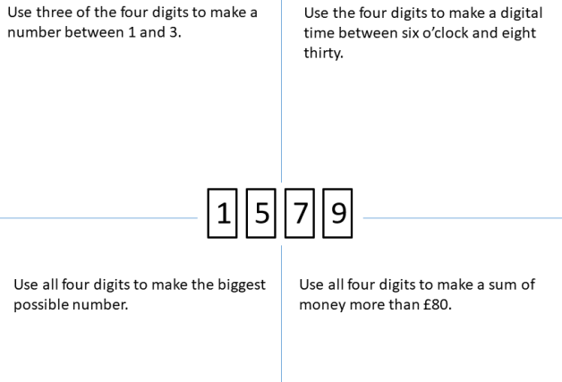
Method Selection
SSDD
SSDD
965
5.69
695
96 x 5
Using each card only once, complete the following inequality:
<
e.g. 1.57
e.g. 9 7 5 1
How many different statements can you make?
12 statements
9751
e.g. £97.51

Slide 8
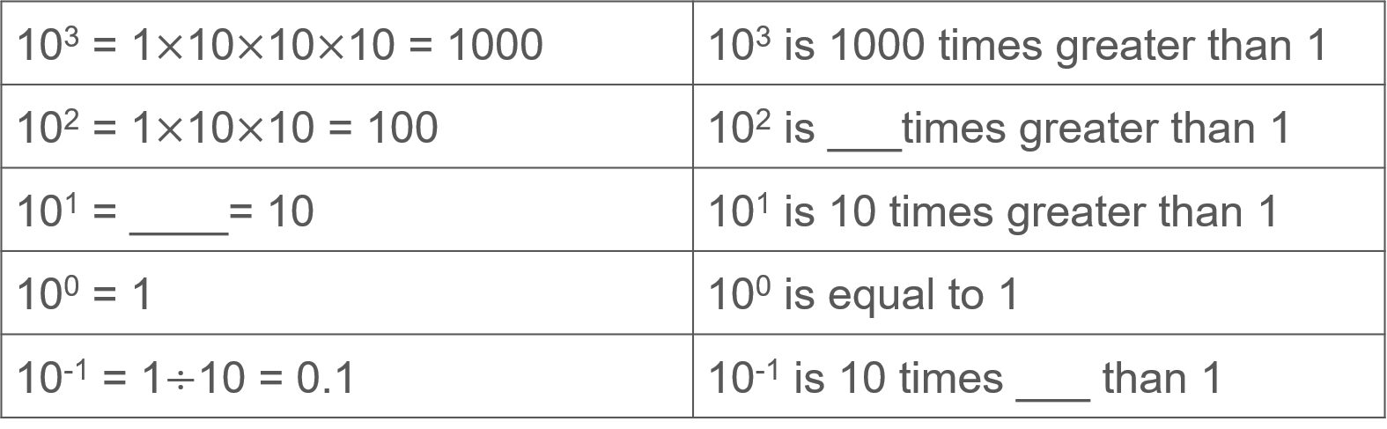
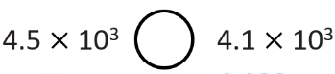

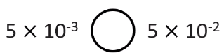
Method Selection (CHALLENGE)
Unfamiliar Contexts
What values can each missing digit take? 4,?90 = 4000 to one significant figure 9,?12 = 10,000 to one significant figure 34,?90 = 30,000 to one significant figure 678? = 7000 to one significant figure
When rounding an integer to three significant figures, the answer is 13 700. How many possibilities are there for the original integer? You do not need to list them all.
Fill in the gaps: If the pattern continues, what would the next row be?
Write >, < or = to compare the statements:
4, 3, 2, 1, 0
5, 6, 7, 8, 9
0, 1, 2, 3, 4, 5, 6, 7, 8, 9
0, 1, 2, 3, 4, 5, 6, 7, 8, 9
100
✓
✓
100
1 x 10
smaller
>
>
>

